Slide 1
Employee Attrition Prediction Model
PRESENTED BY
SUBHANI BASHA SHAIK

Slide 2
Abstract
1.Introduction
2.System Requirements
3.Literature Review
4.Data Dictionary
5.Data Preprocessing
6.Exploratory Data Analysis (EDA)
7.Feature Selection
8.Model Building
9.Model Evaluation
10.Model Implementation/Actionable Insights
11.Screenshot
12.Outcome/Output/Results
13.Conclusion
CONTENT

Slide 3
Abstract:
Calculating tenure, creating categorical variables, or aggregating data are essential preprocessing steps. Next, the data is split into training and testing sets to train the model on one portion and evaluate its performance on another, which helps assess how well the model generalizes to new data. Model selection involves choosing appropriate machine learning algorithms for predicting employee attrition, with common choices including logistic regression, decision trees, random forests, and support vector machines. The selected model is then trained on the training data to learn patterns and relationships between employee attributes and attrition. The trained model's performance is evaluated using metrics such as accuracy, precision, recall, and F1-score to assess how well it predicts employee attrition. Hyperparameter tuning is conducted to optimize the model's performance and generalization capabilities, often involving techniques like grid search or randomized search. Once optimized, the trained model is deployed into production to make predictions on new data, which may involve integrating the model into existing HR systems or creating a standalone application. Continuous monitoring and maintenance of the model's performance in production are necessary to ensure it remains accurate and effective over time.

Slide 4
Introduction:
Employee attrition prediction involves forecasting the likelihood of employees leaving an organization based on various factors. In today's dynamic work environment, understanding and managing employee turnover is crucial for organizational success.
What is Data Science?
Data science is like putting on a pair of special glasses that let you see things others can't. Imagine you're at a bustling carnival, surrounded by colorful games and prizes. While everyone else is caught up in the excitement, you, with your data science glasses, start noticing patterns in how people play and win.

Slide 5



System Requirements:
Minimum Software Requirements:
Operating System (OS): Windows 10, mac OS, Linux (Ubuntu, CentOS, etc.)
Platform: Python 3.x
Tools: Anaconda or Miniconda
Minimum Hardware Requirements::
Hard Disk: Minimum 40GB.
RAM: Minimum 8GB of RAM

Slide 6
Literature Review:
In this section, we delve into existing studies and research papers related to employee attrition prediction and retention strategies. By reviewing the work of other researchers and practitioners, we aim to gain valuable insights, identify gaps in the current literature, and build upon existing knowledge to inform our own project.
2.1 Review of Existing Studies and Research Papers
2.2 Key Insights from Literature

Slide 7
Data Dictionary:
In this section, we provide a comprehensive guide to the variables or features included in our dataset. This "data dictionary" serves as a roadmap for understanding the various attributes we've collected and their significance in our analysis of employee attrition.
Employee ID
Age
Gender
Department
Years of Service
Job Role
Salary
Performance Rating

Slide 8
Data Preprocessing:
Cleaning and Handling Missing Data
Standardization and Normalization
Encoding Categorical Variables
Handling Skewed Distributions
Dealing with Outliers
Feature Engineering and Selection

Slide 9
Exploratory Data Analysis (EDA):
Before we delve into the world of Python-based data analytics, let's take a stroll through the fascinating landscape of exploratory data analysis (EDA). This phase is like the warm-up before a marathon, where we stretch our analytical muscles and get a feel for the terrain ahead.
Outcome:
As we conclude our journey through the realm of exploratory data analysis, we reflect on the insights gained and the mysteries uncovered. EDA serves as our compass, guiding us through the twists and turns of the data landscape and illuminating the path ahead. Armed with a deeper understanding of our data, we stand poised to tackle the challenges that lie ahead and unlock the full potential of our dataset.

Slide 10
Feature Selection:
Feature selection is a pivotal process in building an efficient predictive model. It involves identifying and selecting the most relevant variables that contribute significantly to the prediction of employee attrition. This step is crucial for improving model accuracy, reducing overfitting, and decreasing computational time and complexity.
Importance of Feature Selection:
Effective feature selection leads to a simplified model that is easier to interpret and faster to train. By focusing on the most influential variables, the model's performance improves, providing more accurate predictions and actionable insights for human resources strategies. Reducing the number of features also helps in mitigating the risk of overfitting, ensuring that the model generalizes well to unseen data.

Slide 11
Model Building:
Model building is the process of selecting, training, and fine-tuning machine learning algorithms to predict employee attrition. This phase is critical as it transforms the data insights obtained from feature selection into a predictive framework that can generalize well to new, unseen data.
Outcome::
The model building phase culminates in a well-tuned predictive model capable of accurately forecasting employee attrition. This model can then be evaluated using unseen data to confirm its effectiveness before deployment in a real-world setting.

Slide 12
Model Evaluation:
Model evaluation is the process of assessing how well the predictive model performs on new, unseen data. This step is crucial for understanding the model's generalizability and its practical utility in predicting employee attrition.
Outcome::
The evaluation phase confirms that the selected model meets the desired performance criteria. A well-evaluated model provides confidence that it will perform effectively in a real-world setting, offering reliable predictions of employee attrition. This stage also identifies areas for further refinement and optimization to enhance model accuracy and robustness before deployment.

Slide 13
Model Implementation:
Model implementation is the process of deploying the predictive model into a real-world environment where it can generate actionable insights to inform decision-making. This phase involves integrating the model into existing systems, monitoring its performance, and using its predictions to drive strategic actions.
Outcome:
The successful implementation of the predictive model transforms HR decision-making by providing actionable insights that improve employee retention. By proactively addressing attrition risks, the organization can enhance employee satisfaction, reduce turnover costs, and foster a more stable and engaged workforce.

Slide 14
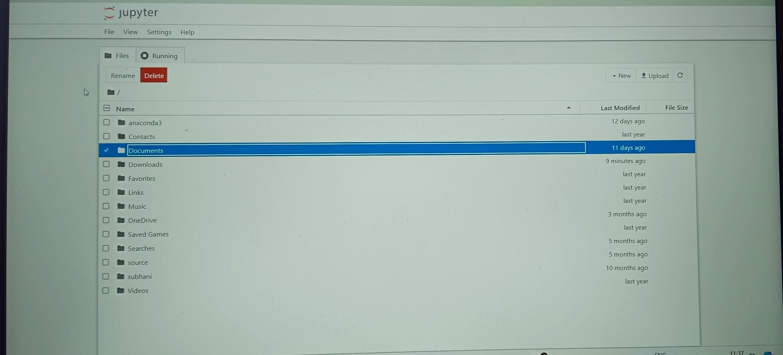
Screenshot:

Slide 15
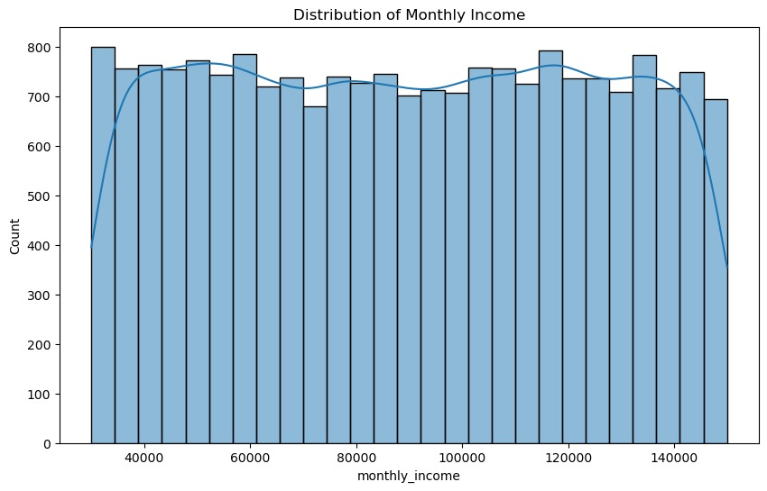
Screenshot:

Slide 16
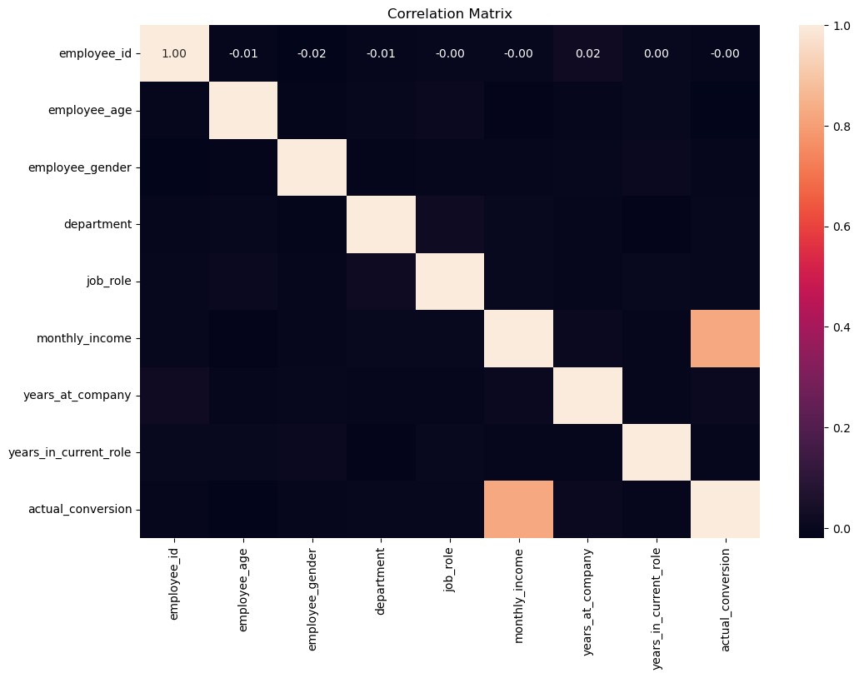
Screenshot:

Slide 17
Results:
The predictive model for employee attrition proved to be a valuable tool for the organization. It not only provided accurate predictions but also translated these predictions into actionable insights that significantly improved employee retention and engagement. The integration of data-driven decision-making into HR practices demonstrated the practical benefits of applying data science to organizational challenges.

Slide 18
Conclusion:
The project successfully demonstrated how data science can transform HR practices, providing actionable insights that lead to tangible improvements in employee retention and organizational efficiency. By embracing advanced analytics, the organization has taken a significant step towards building a more engaged and stable workforce.

Slide 19


